Slide 1


SHRIDEVI HACKATHON 2024
TITLE PAGE
Theme-Monitoring satellite-Based Air Quality Maps Using AI/ML
Team Members Name-Vijeta Vijaykumar Naik
K V Srujana Sree
Bhavani Yellamla
College Name-PES Institute of Technology And Management
SHRIDEVI NATIONAL LEVEL HACKATHON - 2024

Slide 2
MONITORING SATELLITE BASED AIR QUALITY MAPS USING AI&ML
Proposed Solution (Describe your Idea/Solution/PrototypMM
Monitoring Satellite based air quality maps is a powerful way to track
and predict pollution on a large scale , bringing together data from space
advanced analytics to get a clearer picture of air quality everywhere.
Gather Satellite Data: Satellites like Sentinel-5P or GOES collect data on pollutants like nitrogen dioxide, ozone, and particulate matter (PM2.5, PM10) across vast areas. They capture how pollution levels change over time, from daily to seasonal shifts, and even detect sudden spikes.
E 14

Slide 3
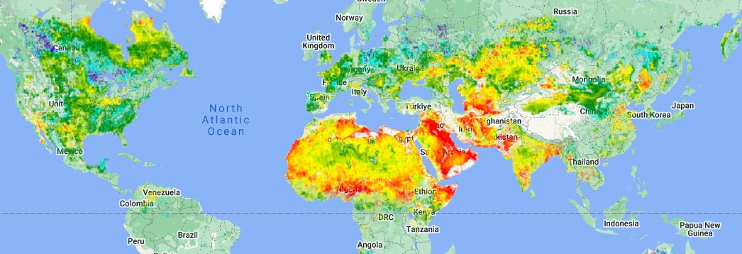
TECHNICAL APPROACH
E 14
Technologies to be use:
Javascript , mySQL , Python, html, css .
Methodology and process for implementation:

Slide 4
FEATURES
E 14
Air quality heat map
Your thoughts our action
breathify
SHRIDEVI NATIONAL LEVEL HACKATHON - 2024

Slide 5
CHALLENGES FACED
E 14
1.Monitoring : locally we cannot access datas for air quality, it is difficult for an individual to know air quality index of his/her own locality.
2.individually we cannot take initiatives to plan for bigger projects like helping in the reduction of air quality without support
3.There ls less interest in people to take small steps in improvement of air quality

Slide 6
Overcome :
1.our website uses real time based satellite data for air quality through which an individual comes to know about their locality
2.This website helps in helping users to target issues on air quality by taking their inputs
3.with the help of Breathify , people develop intrest in their small steps as they can maintain daily streaks and their small steps leads to big difference

Slide 7
E 14
thank you
SHRIDEVI NATIONAL LEVEL HACKATHON - 2024

